Slide 1
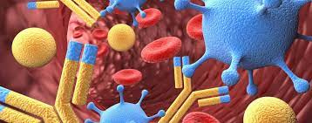
IMMUNOLOGY -Reshma, Shanmathi, Jeeva

Slide 2
GENERAL CONCEPTS OF IMMUNOLOGY
Immunology is the study of biology that deals with the immune system of the body.
Acts as the body’s defense by protecting our body cells.
Functions by recognizing and destroying foreign antigens.
Problems in immune system leads to various diseases from flu to cancer.
Ability to distinguish foreign molecules from self is another fundamental feature of the immune system

Slide 3
IMMUNITY
DEFINITION
Ability of an body to defend itself against disease causing organisms .
EXAMPLE
Skin acts as a barrier to block germs from entering the body.
Antibodies obtained from vaccination

Slide 4
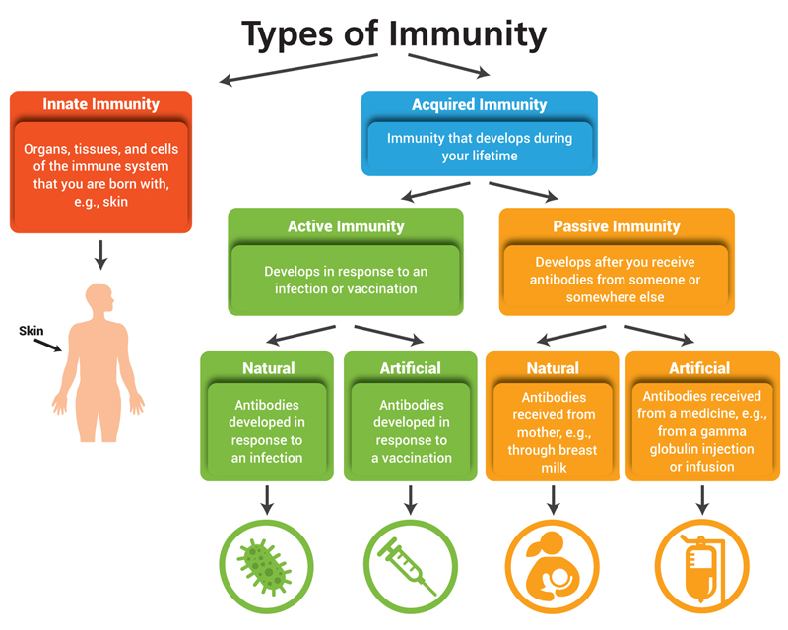
TYPES OF IMMUNITY

Slide 5
INNATE IMMUNITY
Also known as non-specific immunity.
Involves barriers that keeps harmful materials from entering the body.
First line of defence.
ADAPTIVE IMMUNITY
Also known as acquired immunity.
Acquired during their lifetime as a result of exposure to specific antigens ( by vaccination also).
Activated when the innate immune response is insufficient to control an infection.

Slide 6
VARIOUS CELLS OF IMMUNE SYSTEM
IMMUNE CELL
Part of the immune system which helps the body fight infections and other diseases.
Developed from stem cells in the bone marrow and become different types of WBC.
The cells include neutrophils, eosinophils, basophils, mast cells, monocytes, macrophages, dendritic cells, natural killer cells, lymphocytes( B cells and T cells)

Slide 7
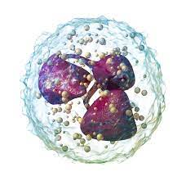
NEUTROPHILS
Most abundant type of granulocytes and make up 40% to 70% of all white blood cells in humans
Infection fighting WBC .
Arrives first on the scene when tissues get damaged.

Slide 8
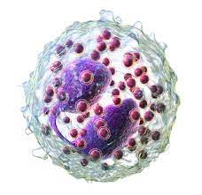
EOSINOPHILS
Less numerous
Releases cytokines
For wound healing
Helps in tissue repair

Slide 9
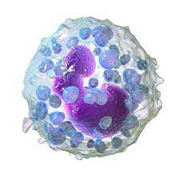
BASOPHILS
Least numerous and plays a role in “immune surveillance”.
Largest type of granulocyte.
Releases the histamine in their granules during an allergic reaction.

Slide 10
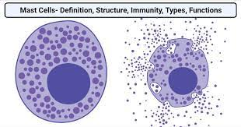
MAST CELLS
Known as mastocyte or labrocyte.
Resident cell of connective tissue that contain many granules rich in histamine and heparin.
Located in areas below the epithelium in connective tissue surrounding blood cells, smooth muscle, mucus and hair follicles.

Slide 11
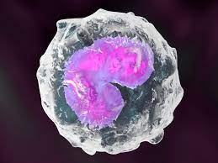
MONOCYTE
Type of leucocyte which can differentiate into macrophages and conventional dendritic cells.
Plays an important role in both the inflammatory and anti-inflammatory process that take place during an immune system
Helps fight bacteria, viruses, and other infections in the body

Slide 12
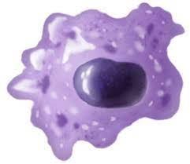
MACROPHAGES
Key components of the innate immune system
Resides in tissues where they functions as immune sentinels.
Specialised cells involved in the detection, phagocytosis and destruction of bacteria and other harmful organisms
PHAGOCYTOSIS : The process of engulfing the foreign materials entering the cells is known as phagocytosis.

Slide 13
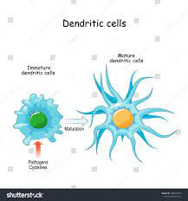
DENDRITIC CELLS
Professional antigens presenting cells that link innate and adaptive immunity.
Found in tissues such as skin and boost immune system.
Responsible for initiating all antigen-specific immune response.

Slide 14
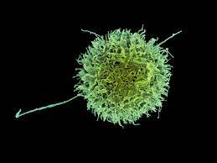
NATURAL KILLER CELLS
Effector lymphocytes of the innate immune system
Control several types of tumours and microbial infections.
Originate from hematopoietic stem cells.
Produce cytokines.

Slide 15
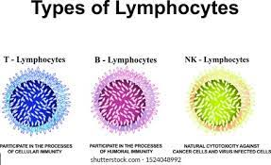
LYMPHOCYTES
Formed from bone marrow.
Two types of lymphocytes: B cells and T cells
B CELLS :
Make antibodies.
Destroy foreign substance and tag them for attack.
T CELLS :
Destroys cells that have taken over by viruses and cancers.

Slide 16
ANTIGEN
WHAT IS AN ANTIGEN?
Known to trigger the immune system(substance that causes the immune system to produce antibodies against it).
TYPES OF ANTIGEN:
EXOGENOUS (Foreign to the immune system)
ENDOGENOUS (Produced by intracellular bacteria and virus replicating inside a host cell)
AUTOANTIGENS (Produced by the host)

Slide 17
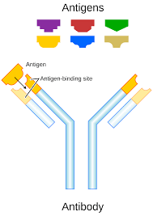
STRUTURE OF ANTIGEN
The epitopes or antigenic determiners are the components of antigens.
An antibody has at least two binding sites
That can bind to specific epitopes on antigens.
The antigens combine with the antibody
According to the lock and key mechanism.
The ability of the body to act against the disease
-causing agents and antigens by the immune system
Is termed as immunity.

Slide 18
PROPERTIES OF ANTIGENS
The properties of the antigens are as follows:
The antigen should be a foreign substance to induce an immune response
The antigen should have a molecular mass of 14,000 to 6,00,000da
They are mainly proteins and polysaccharides.
The more chemically complex they are, the more immunogenic they are.
Antigens are species-specific.
The age influences the immunogenicity.

Slide 19
FACTORS INFLUENCING ANTIGENICITY
Antigenic stimulation varies depending on the dosage of antigen administered, route of administration and use of adjuvant etc..
Molecular weight of the antigen affect the antigenicity as low molecular antigens can only combine with the antibody.
Very low molecular weight substance cannot act as an antigen.
Very large molecular antigen directly induces the B cell differentiation with out the involvement of T cells.
Degradability is essential as in the antigen presenting cells process the antigen by degrading them.
Antigen induced antibody response can be supressed by administrating the antibody passively either prior to or shortly after administration of antigen.

Slide 20
ANTIGENICITY
Antigenicity is the ability to specifically recognized by the antibodies generated as the result of the immune response to the given substance.
There are low molecular weight substances which are capable of producing an immune response, called haptens.
IMMUNOGENICITY
Immunogenicity is the ability of cells or foreign particles to provoke an immune response.
Example : vaccination.
The three characteristics are foreignness, high molecular weight and chemical complexity.

Slide 21
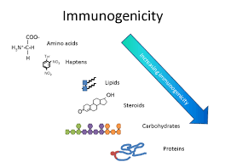
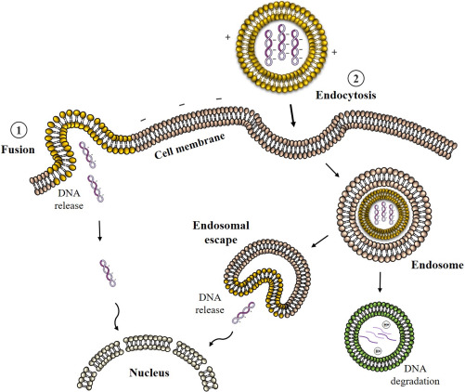
IMMUNOGENICITY
ANTIGENICITY

Slide 22
ANTIBODY
WHAT ARE ANTIBODIES?
Also known as immunoglobulin.
Specific type of protein that helps the body to fight and ward off the disease.
Protein produced by the body immune system when it detects harmful substances called antigens.

Slide 23
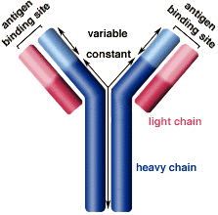
STRUCTURE OF ANTIBODY
Y-Shaped structure made up of four Polypeptide subunits.
Each subunit has Two identical light and heavy chains
The N-terminus of each chain forms an Antigen binding domain
with light chain.
The C-Terminus of the heavy chain forms ‘fragment crystallization’,
which helps in the Interaction with the effector cells
All four polypeptide subunits are held Together by disulfide
and non-covalent bonds.
The heavy chains of the antibodies contain a Variable region and three
constant regions.
Each antibody has two identical antigen-binding Sites and they differ in
the antibodies.

Slide 24
PROPERTIES OF ANTIBODY
IgG
Main antibody in blood and plays an important role in the biological defence system.
Only isotope that can pass through the placenta, and IgG transferred from the mother’s body protects a new born.
IgM
Constructed of five units of basic Y-shaped structures and is mainly distributed to blood.
Produced first upon pathogen invasion by B cells.
Has key role in the initial immune system.

Slide 25
IgA
Mainly present as monomers, but forms dimers in secretions such as bowel, fluid, etc.
Prevent bacterial invasion from a mucous membrane.
Present in breast milk and protects the gastrointestinal tract of new born.
IgD
Present on the surface of B cells
Plays a role in the induction of antibody production
Prevention of respiratory tract

Slide 26
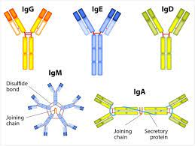
IgE
Originally related to immunity reactions to parasites.
By binding to mast cells, it is believed to be involved in allergies such as pollinosis.

Slide 27
FUNCTIONS OF ANTIODIES
Binds to pathogens.
Activates the immune system in case of bacterial pathogens.
Directly attacks viral pathogens.
Provides long term protection against pathogens.
Assist in phagocytosis.
Neutralises the bacterial toxins .
Act as a first line of defence for mucosal surfaces.
Ingest cell by phagocytosis.

Slide 28
ANTIGENIC DETERMINANCE
Epitope, also known as antigenic determinant, portion of a foreign protein , or antigen that is capable of stimulating an immune response .
examples: thyroglobulin, DNA, corneal tissue, etc…
Formed ither by adjacent amino acids or those amino acids that have been brought close by the tertial conformation of the protein.
Stimulate the formation of particular kind of antibody or effector cell.

Slide 29
PRODUCTION OF MONOCLONAL ANTIBODIES
The process usually starts with generation of mAb-producing splenocytes.
B cells typically sourced from animals, usually mice.
After cell fusion, a large number of clones are screened and selected on the basis of antigen specificity.
Once candidate hybridoma cell lines are identifies , each hit confirmed, validated and characterised using a variety of own strea functional assays.
Upon completion, space the clones are scaled up were additional downstream bio processes occur.

Slide 30
PRODUCTION OF POLYCLONAL ANTIBODIES
produced by injecting a specific antigen into lab animals.
Mixture of heterogenous which are usually produced by different B cell clones in the body
After being injected to elicit a primary immune response , the animal is given a secondary or a tertiary immunisation to produce higher antibodies against a particular antigen
After immunisation it can be obtained it can be obtained straight from the serum or purified to obtain a solution which is free from other serum proteins.

Slide 31
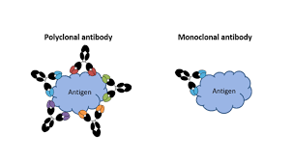
MONOCLONAL AND POLYCLONAL ANTIBODIES

Slide 32
THE END

